Slide 1
Facial Emotion Recognition with CNN
By Aswin Matthews Ashok
Instructor: Dr. Dapeng Wu
EEL 6825: Pattern Recognition
Spring 2016
University of Florida

Slide 2
Convolutional Neural Network (CNN)
CNNs are neural networks which are sensitive to spatial information. They are capable of recognizing complex shapes and patterns in a given image and are used for a wide variety of image classification algorithms.

Slide 3
About the Project
In this project I built a CNN which is capable of classifying eight facial emotions (Neutral, Anger, Contempt, Disgust, Fear, Happiness, Sadness and Surprise) with high degree of accuracy.
The programs are written to run on Python 3.6
Anaconda Navigator was used in this project.
The LBP Cascade Classifier for frontal face detection available in OpenCV has been used to detect faces in images.
The CNN for detecting facial emotions was built using Keras.
The images used in this project are from Cohn-Kanade (CK and CK+) database

Slide 4
Program Modules
faceDetectorInterface.py | Contains the code which leverages OpenCV’s LBP Cascade Classifier for frontal facial detection in order to detect the faces in a given image
ckPlusInterface.py | This module is used to navigate the CK+ dataset, detect the faces in the images using the faceDetectorInterface.py module and store them in separate folders categorized by their emotions.
dataInterface.py | Controls the work done by the ckPlusInterface.py and consolidates the labeled faces and stores them into data.npy and labels.npy files.
emotionRecognitionNetwork.py | Designs and trains the CNN according to specifications, stores the network into a file and provides functionality to use the trained network to make predictions
cnnInterface.py | Used to specify the CNN network structure, data pre-processing and exposes interfaces to enable other applications to use the network for predictions.
applicationInterface.py | Contains applications which detect faces from webcam feeds, videos and the screen and classifies their emotions from webcams, videos and the screen.
masterControl.py | User interface which runs the other modules.

Slide 5
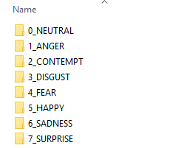
Data Pre-processing
The images in the CK+ database were scanned to extract the portion of the image which contains the face.
The detected faces were resized into 100X100 images and stored into directories named after different emotions

Slide 6
Data Pre-processing (continued)
The images stored in the emotion was manually inspected to remove any flawed images.
The images were then consolidated into the data.npy file and their corresponding labels were stored in the labels.npy file. During this process, emotions with poor representation were identified and additional images with minor amount of noise were added into the nympy files to ensure that every emotion is equally represented for training.

Slide 7
Emotion Recognition Network
The data was imported from data.npy and labels.npy files, randomly shuffled and split into a training dataset containing 80% of the images, a testing dataset containing 10% of the images and the validation dataset containing 10% of the images.
The CNN contains 32 filters in the first layer with ReLU, 64 filters on the second layer and 128 filters on the third layer. All layers use ReLU activation. Max Pooling was done after every CNN layer to improve speed of the network.
A Dense network was built over the CNN. It contains 20 neurons on the first layer with ReLU activation and 8 neurons on the second layer with Softmax activation.
Batch normalization was done before every layer in the network.

Slide 8
Emotion Recognition Network (continued)
Input
Max Pooling, Pool size 2
Output
Batch Normalization
Dense 20 neurons ReLU
Batch Normalization
Conv 128 3X3 filters ReLU
Dense 8 neurons Softmax
Max Pooling, Pool size 2
Batch Normalization
Batch Normalization
Conv 64 3X3 filters ReLU
Batch Normalization
Max Pooling, Pool size 2
Conv 32 3X3 filters ReLU
Network Structure

Slide 9
Emotion Recognition Network (continued)

Slide 10
Emotion Recognition Network (continued)
Pred
 | 0_NEUTRAL | 1_ANGER | 2_CONTEMPT | 3_DISGUST | 4_FEAR | 5_HAPPY | 6_SADNESS | 7_SURPRISE
0_NEUTRAL | 94 | 3 | 1 | 14 | 2 | 8 | 5 | 8
1_ANGER | 1 | 118 | 0 | 0 | 0 | 0 | 3 | 0
2_CONTEMPT | 0 | 0 | 144 | 0 | 0 | 0 | 0 | 0
3_DISGUST | 0 | 0 | 0 | 133 | 0 | 0 | 0 | 1
4_FEAR | 0 | 0 | 0 | 0 | 100 | 0 | 0 | 0
5_HAPPY | 0 | 1 | 0 | 0 | 0 | 126 | 1 | 0
6_SADNESS | 0 | 0 | 0 | 0 | 0 | 0 | 127 | 0
7_SURPRISE | 1 | 0 | 0 | 2 | 0 | 0 | 0 | 118
Actual
Confusion Matrix with 94.96% accuracy

Slide 11
Applications
The first application was built to detect facial emotions in real-time webcam feed.
The second application was built to detect facial emotions in a given video.
The third application was built to detect facial emotion of the images on a computer screen.
All applications use the faceDetectorInterface.py module to detect faces in images and the trained CNN to classify the faces by emotions

Slide 12
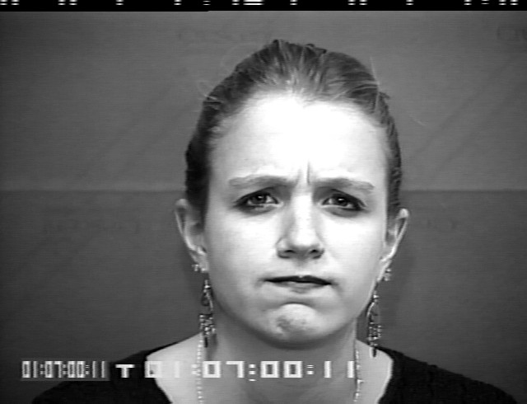
Demo Anger ©Jeffrey Cohn

Slide 13

Demo Sadness ©Jeffrey Cohn

Slide 14
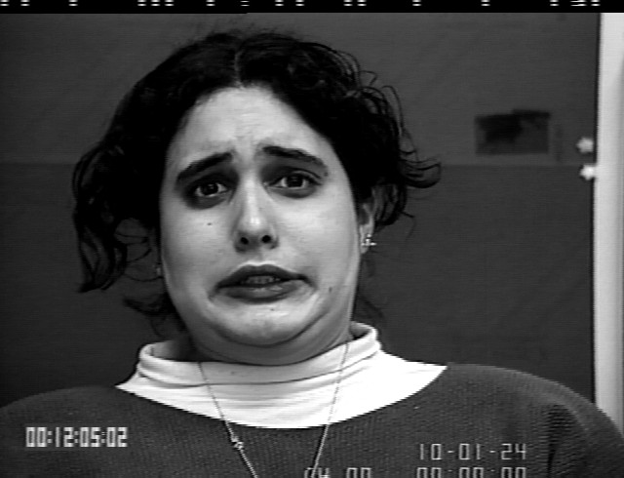
Demo Fear ©Jeffrey Cohn

Slide 15
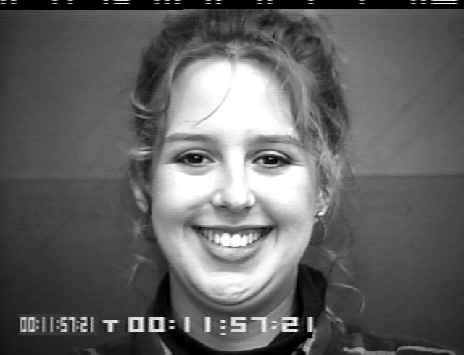
Demo Happiness ©Jeffrey Cohn

Slide 16

Demo Color Image Outside the CK+ dataset

Slide 17
Thank You

